Slide 1
Importance of the Course for BS(CS) Students

Slide 2
What is Electronics?
Importance for CS Students
The branch of physics and technology concerned with the design of circuits using transistors and microchips, and with the behaviour and movement of electrons in a semiconductor, and conductor.
Computers are constructed with Silicon based electronics devices such as Transistors, diodes
Semiconductor devices are the backbone of a microprocessing chip.
Embedded system is a field based on Computer Science and Electrical Engineering

Slide 3
Physical Quantities and Units

Slide 4
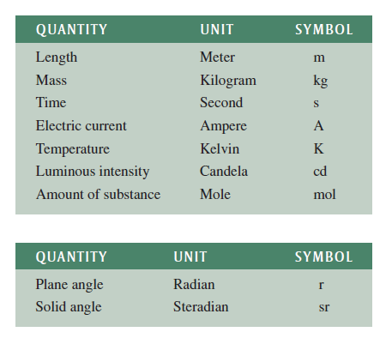
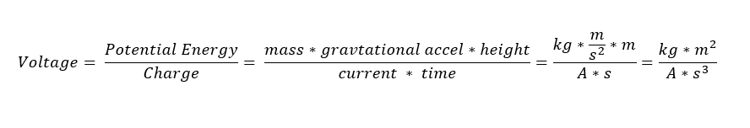
Fundamental and Derived Units
The SI system is based on seven fundamental units (sometimes called base units) and two supplementary units. All measurements can be expressed as some combination of fundamental and supplementary units.
BASIC UNITS
The fundamental electrical unit, the ampere, is the unit for electrical current.
Current is abbreviated with the letter I (for intensity) and uses the symbol A (for ampere). The ampere is unique in that it uses the fundamental unit of time (t) in its definition (second).
All other electrical and magnetic units (such as voltage, power, and magnetic flux) use various combinations of fundamental units in their definitions and are called derived units.
Supplementary UNITS

Slide 5
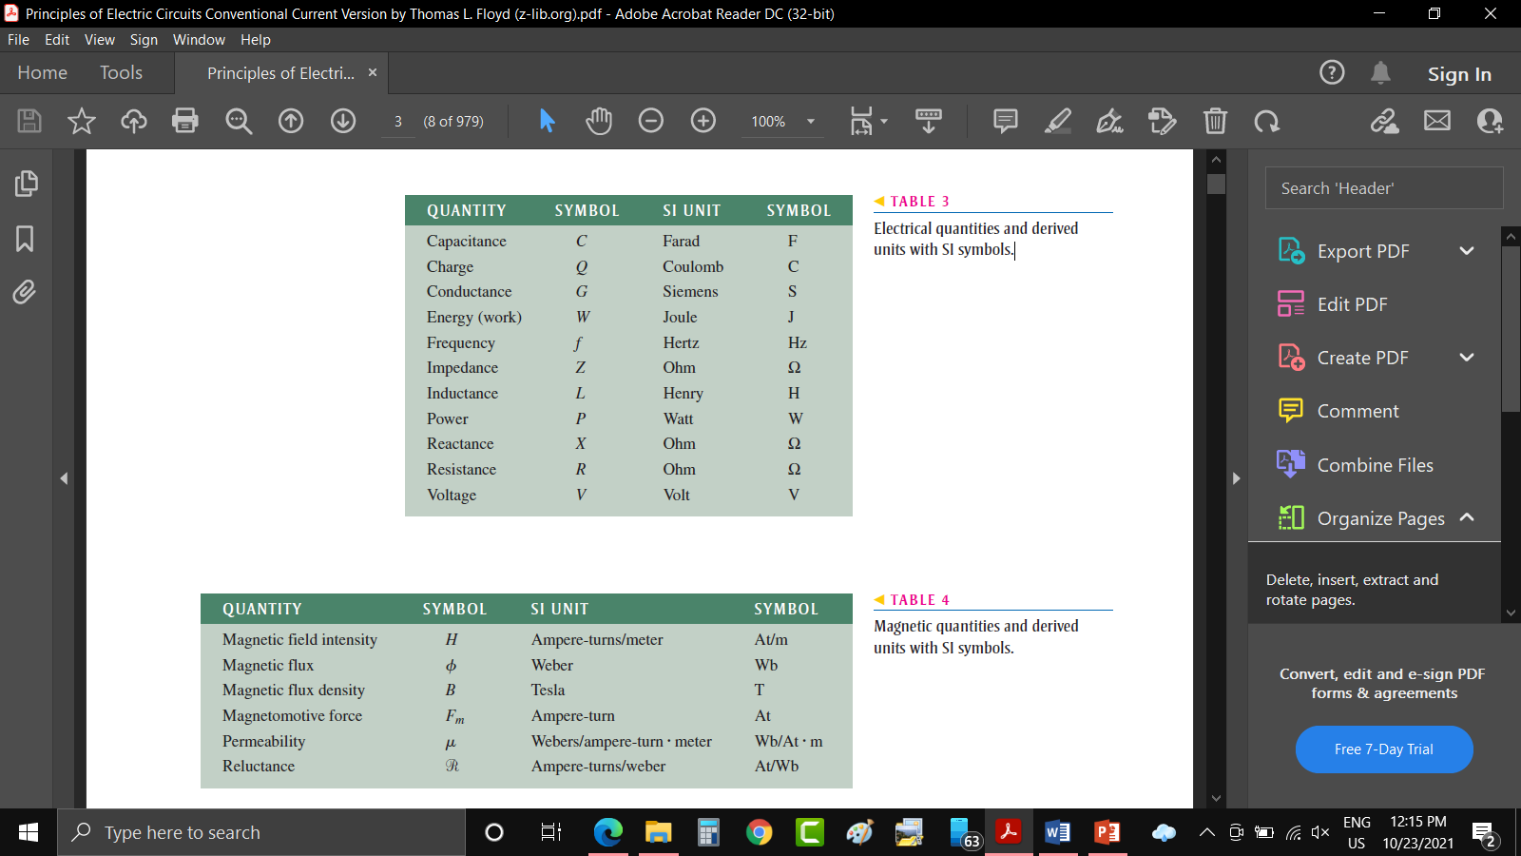
Electrical quantities and derived units with SI symbols.

Slide 6
Magnetic quantities and derived units with SI symbols

Slide 7
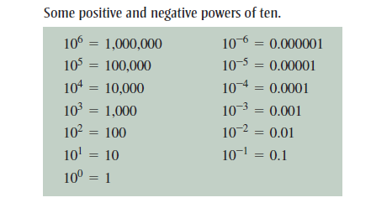
SCIENTIFIC NOTATION
Powers of Ten
In electrical and electronics fields, both very small and very large quantities are commonly used.
electrical current values of only a few thousandths or even a few millionths of an ampere and to have resistance values ranging up to several thousand or several million ohms.
Scientific notation provides a convenient method to represent large and small numbers and to perform calculations involving such numbers
In scientific notation, a quantity is expressed as a product of a number between 1 and 10 and a power of ten

Slide 8
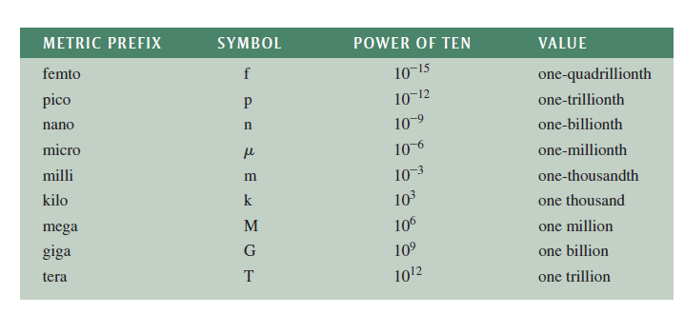
Metric Prefixes

Slide 9
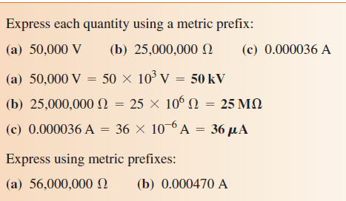
Metric Prefixes Examples

Slide 10
METRIC UNIT CONVERSIONS
It is sometimes necessary or convenient to convert a quantity from one unit with a metric prefix to another, such as from milliamperes (mA) to microamperes ( µA)
Example 1: Convert 0.15 milliampere (0.15 mA) to microamperes (µA)
Example 2: Convert 4500 microvolts (4500µV) to millivolts (mV).

Slide 11
Reference Book
Principles of Electric circuits by Thomas. L. Floyd 9th edition

